Slide 1
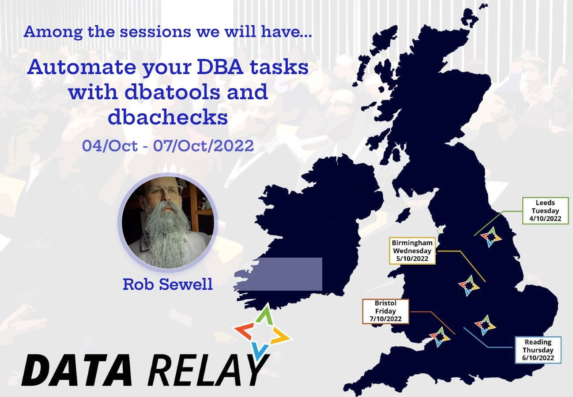


Slide 2






Rob Sewell
He/Him
Bearded Consultant
Automator
Trainer
Consultant Sewells Consulting Ltd
beard.media/book dbachecks PowerShell & Data Community
/robsewellsqldba
@sqldbawithbeard
blog.robsewell.com

Slide 3
What are we going to talk about?

Slide 4


Slide 5
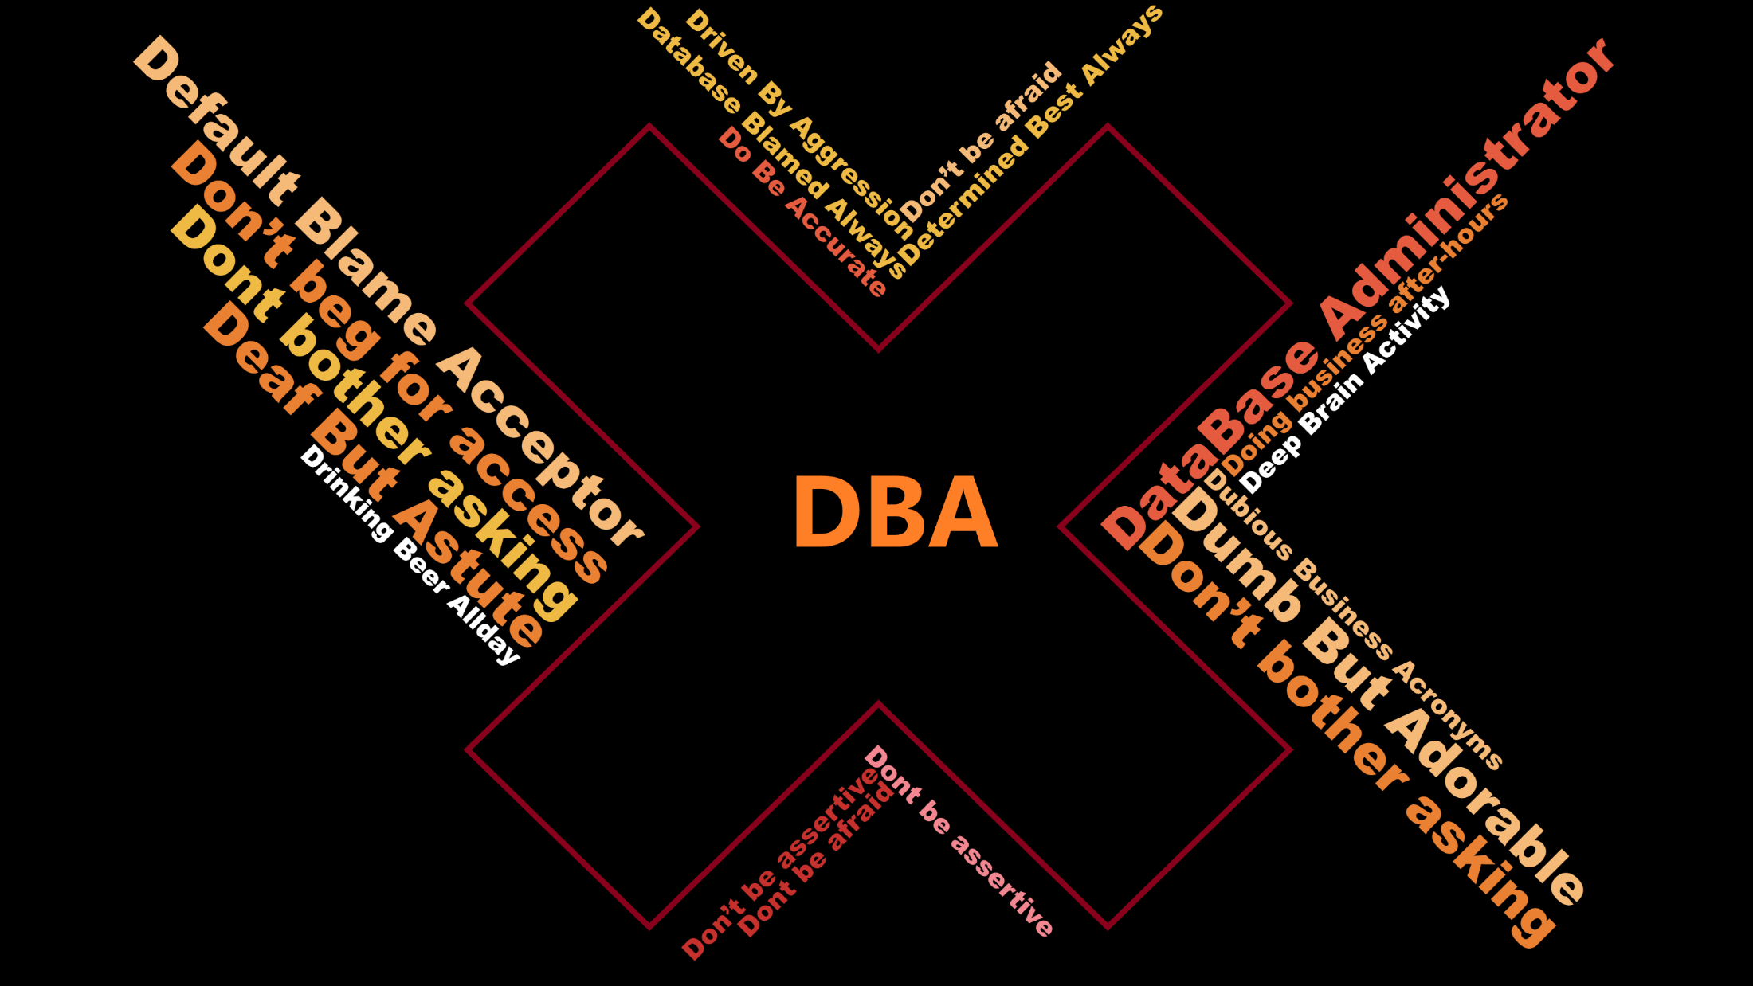

Slide 6
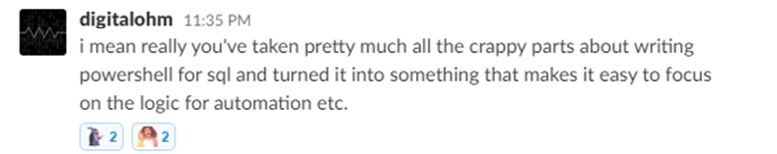
What is dbatools?

Slide 7

What is dbatools? – basically

Slide 8
What is dbatools? – actually
Photo by Kasya Shahovskaya on Unsplash

Slide 9

What is dbatools? – well basically
Notes:
We make it easy

Slide 10
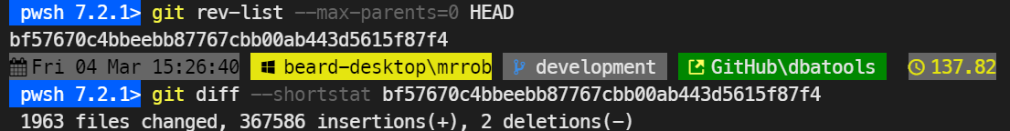

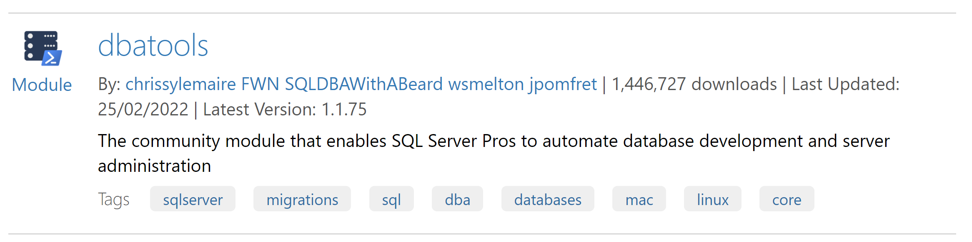
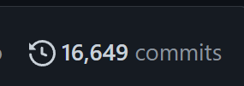
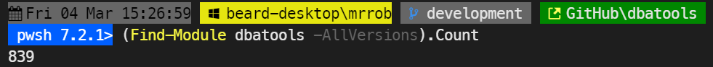
07/2014
06/2016
32 Contributors
Published to GitHub & ScriptCenter
03/2018
03/2022
SQL Community Slack Was Born
MIT Licence
06/2016
01/2017
06/2019
07/2014
First Community Contirbutions
The Road to 1.0 starts
Dbatools 1.0
Need to Migrate Sharepoint databases
Notes:
j

Slide 11





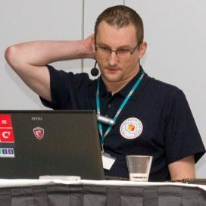




















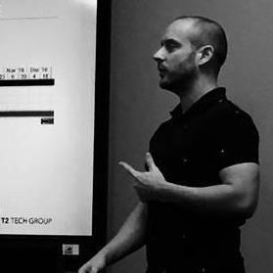











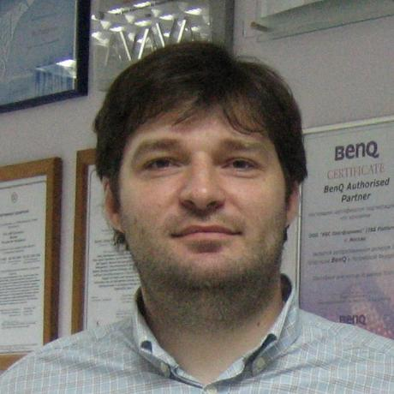






07/2014
06/2016
32 Contributors
Published to GitHub & ScriptCenter
SQL Community Slack Was Born
03/2018
11/2019
MIT Licence
07/2014
06/2016
01/2017
06/2019
Need to Migrate Sharepoint databases
First Community Contributions
The Road to 1.0 starts
Dbatools 1.0
Notes:
j

Slide 12
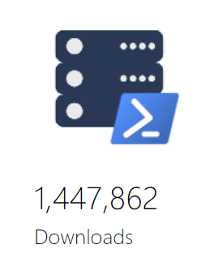
And on and on and on it goes – too much to list here in detail – too many more people who should not be left out. Dbatools 1.1.0 was released July 23rd 2021 – It’s 1.1.75 already today (when I write this slide – might will be more by the time you see this slide!!!)
Notes:
j

Slide 13
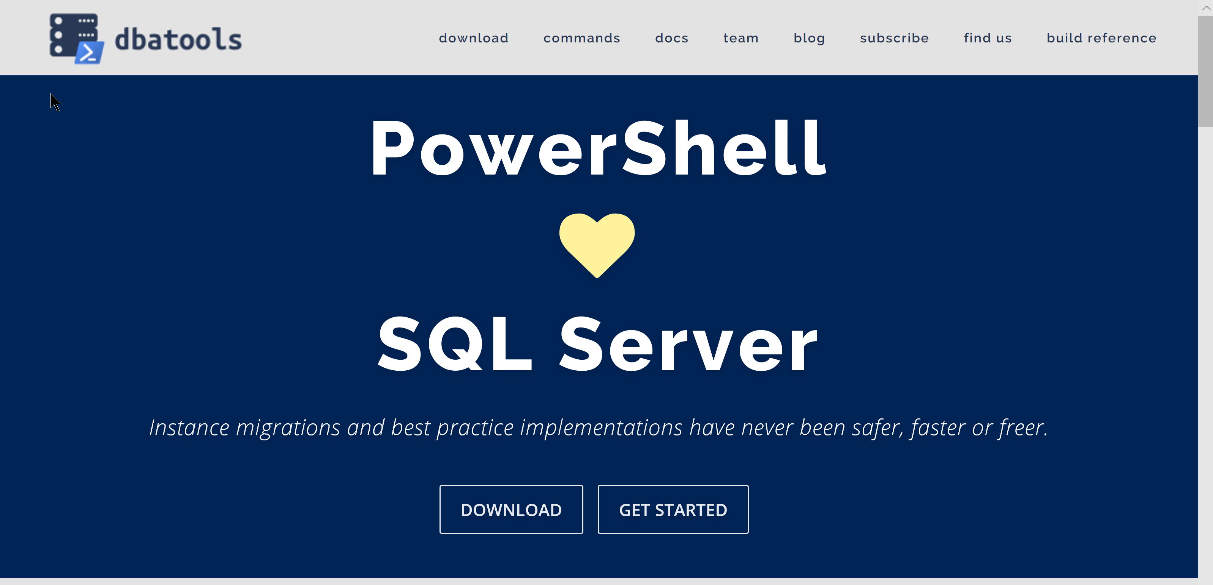
dbatools.io

Slide 14









Sponsors
Thank you!
We couldn’t do it without you.

Slide 15

Register Now events.sqlbits.com/2023
Register Now events.sqlbits.com/2023
Submit Sessions
sessionize.com/sqlbits-2023 sessionize.com/sqlbits-trainingdays2023
Volunteer beard.media/sqlbits-helpers

Slide 16

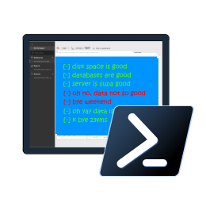
dbachecks

Slide 17
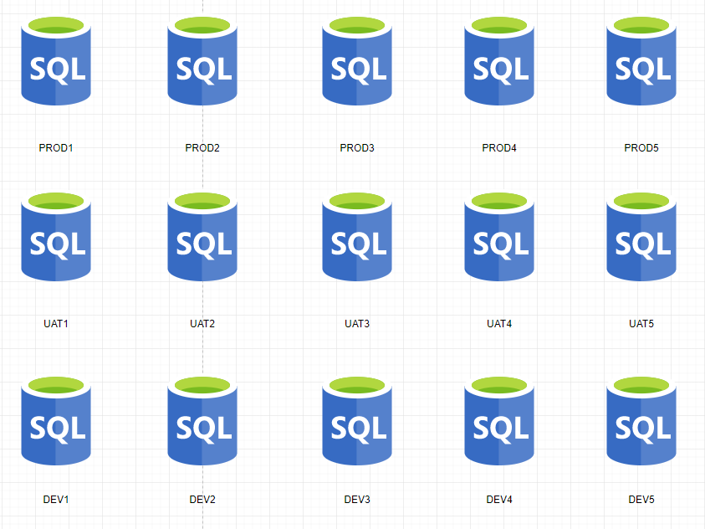
Consider Your SQL Environment

Slide 18
Consider Your SQL Environment
PRODUCTION
No SA account
Backup Compression
FULL Recovery
Secure Backup Location
Agent Alerts
Production Agent Jobs
Only Certain Production AD Groups allowed
And much more

Slide 19
Consider Your SQL Environment
TEST
Different Backup Strategy
Test Agent Jobs
Needs the Testers AD Groups
And much more

Slide 20
Consider Your SQL Environment
Development
Simple Recovery
No Agent Jobs
Definitely no Production AD Information
SA Account
And much more

Slide 21
Consider Your SQL Environment
Widget One
Global view of one ‘widgets’ environments might be needed for
Project Managers
Team Leaders
Release Managers
Agile Teams

Slide 22
Consider Your SQL Environment
Special Snowflakes
For those ‘special’ SQL Servers that don’t fit in the usual boxes
I.E. SharePoint

Slide 23
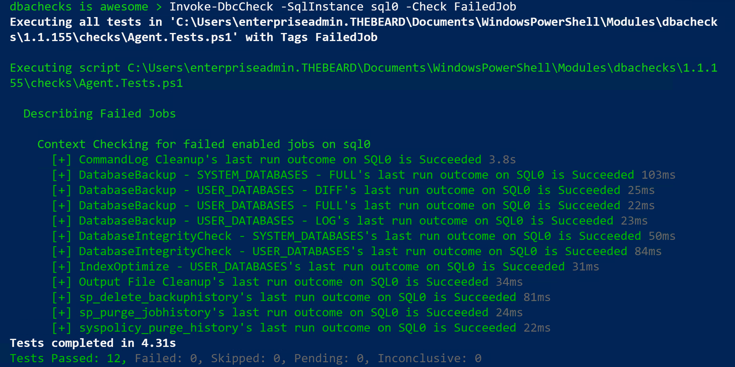
Output
DBAs may need output instantly

Slide 24
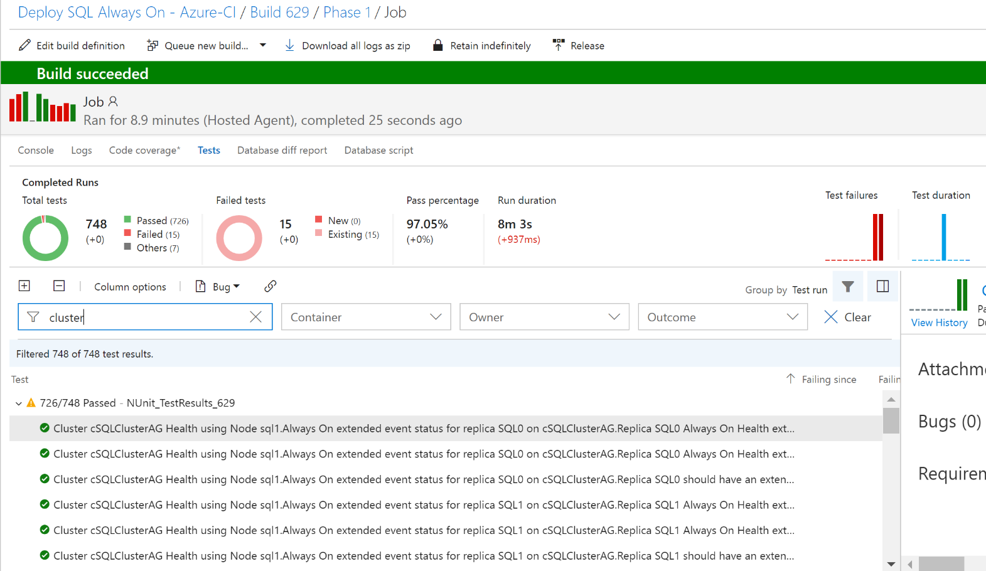
Challenge - Output
DBAs may want to automate and integrate with other solutions (DevOps, Daily Checks, Incident Response, Maintenance Windows)

Slide 25
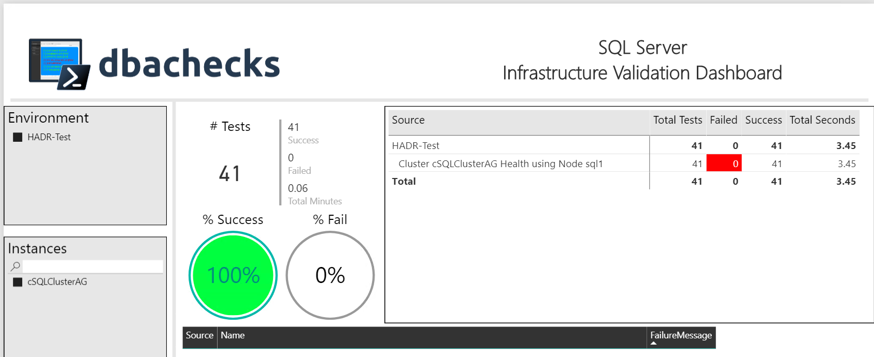
Challenge - Output
Management want output they understand
– (and with pretty interactive pictures !)

Slide 26


Slide 27

Hey Beardy !
MUST BE TIME FOR A DEMO

